Slide 1
Multiplexing Techniques and PSTN Hierarchy

Slide 2
Objectives
At the end of this session, you will be able to:
  Understand the need of multiplexing/demultiplexing
  Classify multiplexing techniques
  Understand TDM, FDM and WDM multiplexing techniques w.r.t. concept, scheme, pros and cons
  Draw and understand Plesiochronous Digital Hierarchy (PDH) used in American and European standard
  Understand the difference between digital trunk lines T1, T2, T3 and T4 / E1, E2, E3 and E4
CONFIDENTIAL© Copyright 2008 Tech Mahindra Limited

Slide 3
Agenda
Need of multiplexing
Multiplexing techniques classification
Time Division Multiplexing [TDM]
Frequency Division Multiplexing [FDM]
Wavelength Division Multiplexing [WDM]
Plesiochronous Digital Hierarchy (PDH)-European and American standard
CONFIDENTIAL© Copyright 2008 Tech Mahindra Limited

Slide 4
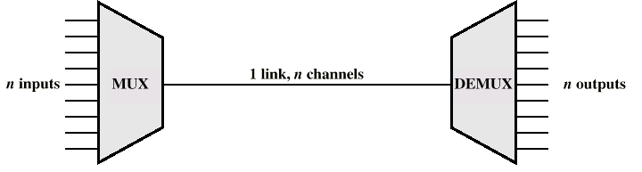
Multiplexing Techniques
Transmitting several entities on the same physical medium (such as a wire pair or air)
  Time Division Multiplexing (TDM)
  Frequency Division Multiplexing (FDM)
  Wavelength Division Multiplexing (WDM)
CONFIDENTIAL© Copyright 2008 Tech Mahindra Limited
Notes:
Multiplexing is used to reduce transmission costs - several channels along the same route share the same transmission medium, such as optical fibre
By the way, why is multiplexing required ?
Explain concept of sharing and how to use shared medium ?

Slide 5
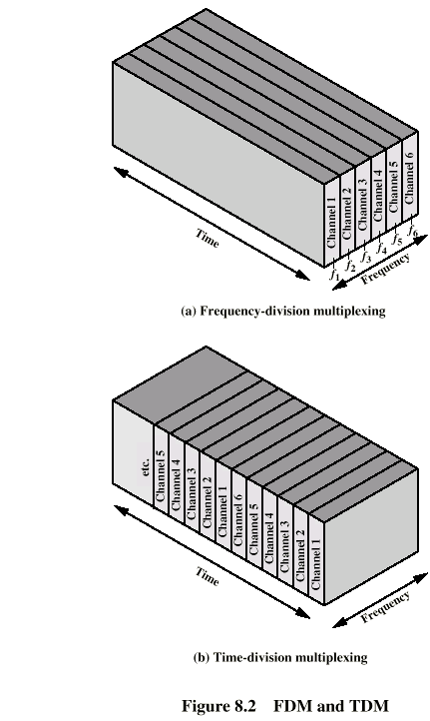
Frequency Division Multiplexing
S1
S2
S3
S4
S5
S6
c
f
t
CONFIDENTIAL© Copyright 2008 Tech Mahindra Limited
Notes:
Separation of the whole spectrum into smaller frequency bands
A channel gets a certain band of the spectrum for the whole time

Slide 6
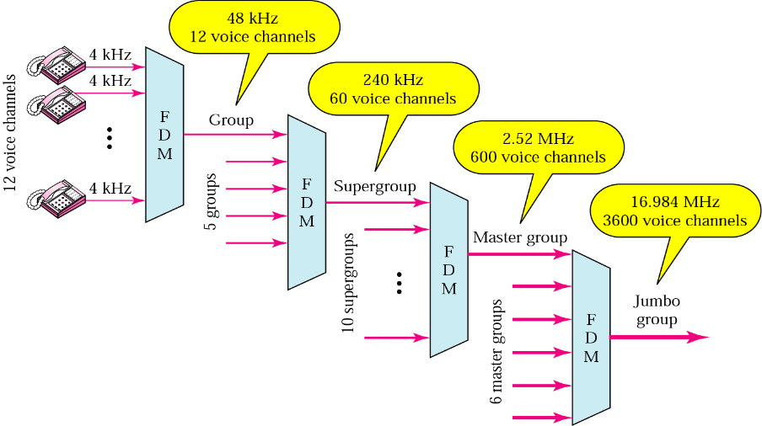
Analog Mux hierarchy
CONFIDENTIAL© Copyright 2008 Tech Mahindra Limited

Slide 7
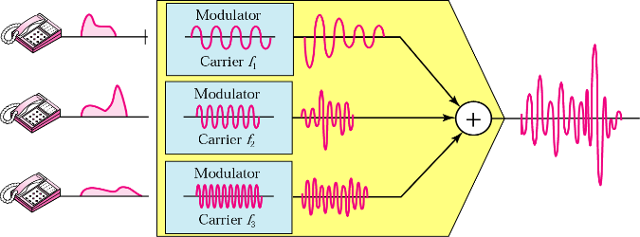
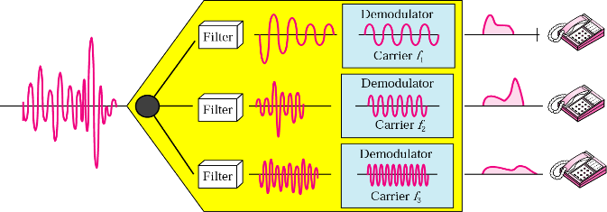
FDM : Multiplexing and De-multiplexing
Disadvantages
  waste of bandwidth if the traffic is distributed unevenly
  guard spaces required
Advantages
  no dynamic coordination necessary
  works also for analog signals
Applications
  Radio , TV
CONFIDENTIAL© Copyright 2008 Tech Mahindra Limited
Notes:
Analogy is : Express high way with lanes where is multiple cars are going simultaneously…In a sense, here bandwidth of road is divided..

Slide 8
Time Division Multiplexing
CONFIDENTIAL© Copyright 2008 Tech Mahindra Limited

Slide 9
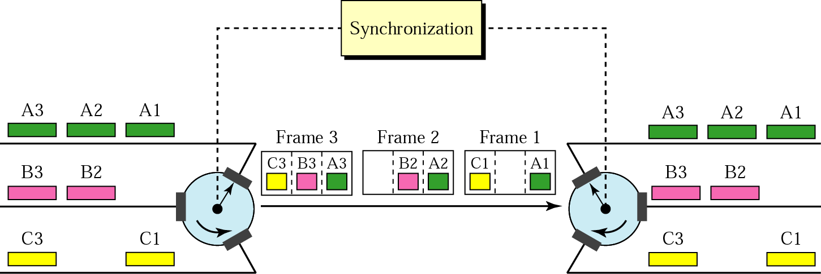
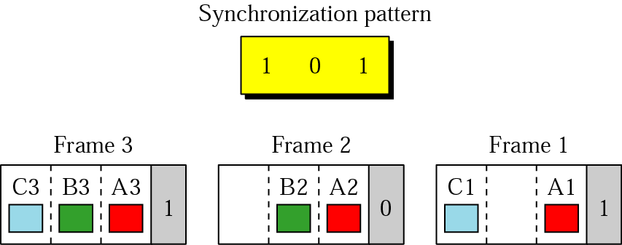
Time Division Multiplexing
CONFIDENTIAL© Copyright 2008 Tech Mahindra Limited

Slide 10
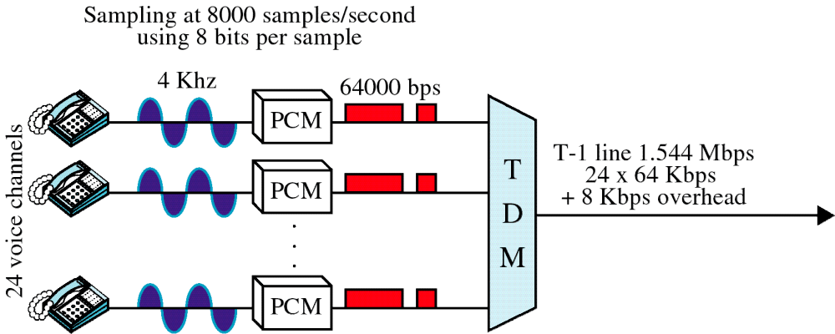
24-Channel PCM/TDM Process
CONFIDENTIAL© Copyright 2008 Tech Mahindra Limited
Notes:
Advantages
only one carrier in the medium at any time
throughput high even for many users
Disadvantages
precise synchronization necessary
Wastage of bandwidth of if nothing present at that timeslot
Applications
Telephony

Slide 11
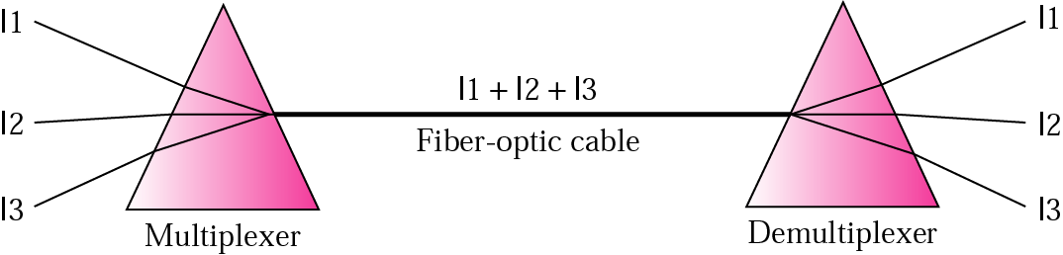
Wavelength Division Multiplexing [WDM]
What do you divide here ?
Prisms in WDM multiplexing and demultiplexing
CONFIDENTIAL© Copyright 2008 Tech Mahindra Limited

Slide 12
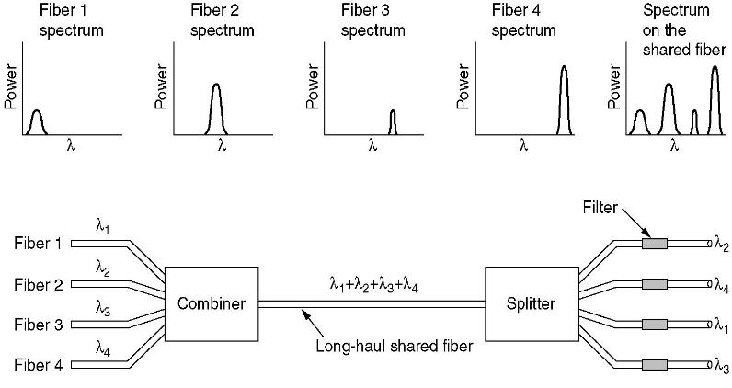
Wavelength Division Multiplexing
CONFIDENTIAL© Copyright 2008 Tech Mahindra Limited

Slide 13
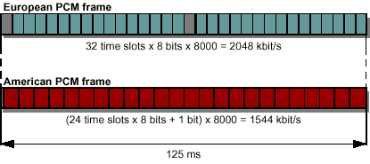
Plesiochronous Digital Hierarchy (PDH)
Time division multiplexing in PSTN
Why two different systems across the world?
CONFIDENTIAL© Copyright 2008 Tech Mahindra Limited
Notes:
The NA & Europeans decided on 2 different compression techniques base on μ-Law & A-law respectively.
This led to 2 different incompatible PCM systems throughout the world.

Slide 14
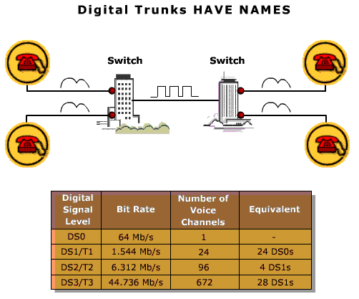
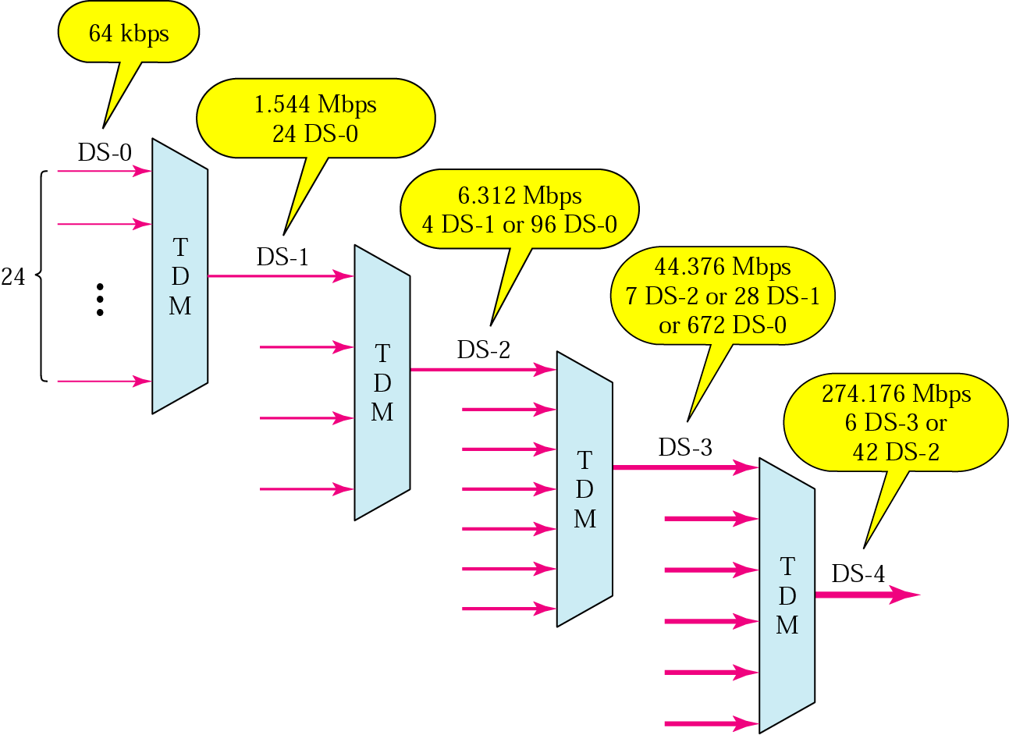
Digital Trunks - T1 T2 and T3
CONFIDENTIAL© Copyright 2008 Tech Mahindra Limited

Slide 15
Difference between a T1 and DS1
T1 defines a physical attribute of a transmission system operating at 1,544 Mb/s
  Cabling
  Regenerator Spacing
  Connectors
DS1 defines a 1.544Mb/s digital signal format
  Pulse shapes
  Frame Format
A T1 carrier typically carries a DS1 Signal
A DS1 may also be carried with a higher rate multiplex system such as DS3 or SONET
CONFIDENTIAL© Copyright 2008 Tech Mahindra Limited
Notes:
Now one question that often comes up at this point is T1, and DS1. It is known that they both operate at 1.5 Mb/s, so they say, "Well, what's the difference between the two? Why do I need two words to mean the same thing?” It turns out that they are oftentimes confused, or oftentimes used interchangeably; but there is a difference between them, that if you use them properly, you can avoid some confusion.
T1 refers to the physical transport facility. So, for example, T1 is the connectors, the cabling, the repeater spacing—all the things you need to electrically send the signal at 1.5 Mb/s over twisted wire pair. So we're sending this 1.544 million b/s signal over twisted wire pair using T1 electronics.
Digital Signal Level 1(DS1), is a particular signal format operating at that same 1.5 Mb/s rate. So DS1defines things like the pulse shapes and their spacing, and the framing format and channelization. So in essence, T1 Carrier defines the electrical system to carry the signal; DS1 defines the actual signall. Where you start seeing differences is, for example, a T1 line operating at 1.5 Mb/s, carry a signal format other than a DS1. Similarly, a DS1 signal can be carried on physical facilities other than aT1; for example, over a radio link.
Also, as I go up to the transmission hierarchy— a DS3 carries 28DS1 signals, but it's not carrying any T1s because a T1 is a physical facility . So for a DS3 (which is carried on a T3, by the way) I could have coming in 28 T1s, each of those 28 T1s, is carrying a DS1 signal. I take those DS1 signals off of the T1s, multiplex them together to form a DS3 signal that we'll then carry on a T3.
So the T is the physical facility and its implementation; the DS is the actual signal format that you're carrying. The DS will go on other kinds of physical facilities; the T is a fixed type of physical facility.

Slide 16
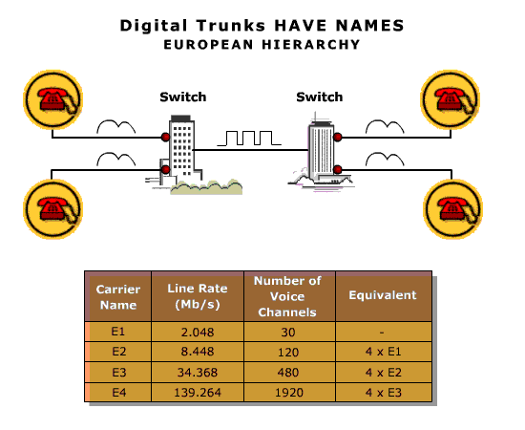
Digital Trunks - E1 E2 E3 and E4
CONFIDENTIAL© Copyright 2008 Tech Mahindra Limited
Notes:
End of the session…

Slide 17
Summary
In this session, we have learned:
  Need of multiplexing/demultiplexing
  Classification of multiplexing techniques
  TDM, FDM and WDM multiplexing techniques w.r.t. concept, scheme, pros and cons
  Plesiochronous Digital Hierarchy (PDH) used in American and European standard
  Difference between digital trunk lines T1, T2, T3 and T4 / E1, E2, E3 and E4
CONFIDENTIAL© Copyright 2008 Tech Mahindra Limited

Slide 18
Thank You

